Slide 1



EKLAVYA:
The Path to Empower Futures
Team Betaoverflow | NIT Rourkela

Slide 2

Agenda
01
Introduction
02
Problems faced by the young graduate community
03
What are people looking for and how we fill in the gap
04
Product Roadmap and App offerings
05
The expansion plan
06
Solution Design & Technology Stack
Product Demo
Notes:
Expertrons Company Profile: Valuation & Investors | PitchBook

Slide 3

Topic 1 of 6
Introduction
<Insert Three points of differentiation>
- Aim: Provide easy access to professional guidance
- Market Differentiation
- Current Market potential

Slide 4



Topic 2 of 6
Problems faced by young graduates
I have no idea what to do with my career
<insert points here>
Lack of opportunities for deserving students
<insert points here>
Lack of information and support
<insert points here>

Slide 5
Topic 3 of 6
What people look for and how we fill the gap
01
02
03
Tier 1
Review LinkedIn &
Resume
Tier 2
Personalized Career
Roadmap
Tier 3
Mock Interview with Industry Experts
<insert points here>
<insert points here>
<insert points here>

Slide 6




Topic 4 of 6
Product Roadmap
01
02
03
Personalized Notifications
Multiple Learning Tracks
Industry Experts as Mentors
<insert points here>
<insert points here>
<insert points here>
Everything is offered by Eklavya
<insert points here>
Notes:
Source: https://databricks.com/blog/2020/08/03/modern-industrial-iot-analytics-on-azure-part-1.html

Slide 7





Topic 5 of 6
The Expansion Plan
Tier 1
Alpha
1x
Job listings from relevant companies
One-time contracts
Yearly contracts
Lifetime contracts
Tier 2
Beta
3x
Tier 3
Gamma
5x
After crossing a 10k userbase, partner with ed-tech startups and companies to feature courses

Slide 8






Topic 6 of 6
Tools & Technologies in Data Science
Backend
Middleware
Frontend
<insert points here>
<insert points here>
<insert points here>
<insert points here>
<insert points here>
<insert points here>

Slide 9
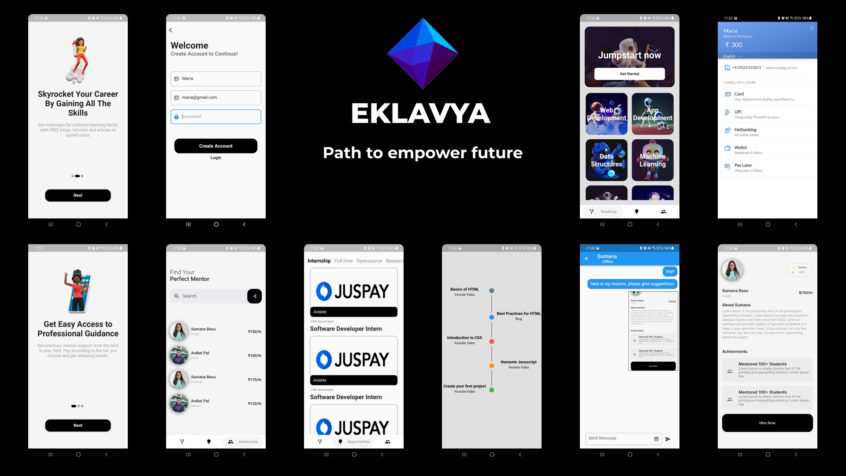
Topic 6 of 6
Tools & Technologies in Data Science

Slide 10
Key Takeaways
01
<Insert Key takeaways>
02
Insert Key Takeaways
03
.
04
.
05
.
06
.
Product Demo
Notes:
Expertrons Company Profile: Valuation & Investors | PitchBook

Slide 11

EKLAVYA:
The Path to Empower Futures
Team Betaoverflow | NIT Rourkela
Q&A Session

Slide 12
EKLAVYA:
The Path to Empower Futures
Team Betaoverflow | NIT Rourkela
Thank you.

